Slide 1
Wide-Area Networks and
Metropolitan Area Networks
Gihan Dias
CS303
060722

Slide 2
What is a WAN?
A network which spans a wide area
Typically over 30 km in diameter
Distinguished from a LAN
  which is generally < 1km diameter
WANs are operated by telecom service providers
LANs are run by individual orgs

Slide 3
What is a MAN?
A network which spans a metropolitan area
  E.g. Colombo Metro – Moratuwa to Ja-Ela
Up to 50 km or so in diameter
Run by Telecom providers

Slide 4
LANs, MANs and WANs
Traditionally, different technologies were used for LANs MANs and WANs
Now they are converging
  Ethernet is used in all three types of networks

Slide 5
Contents of this presentation
Technologies which are primarily used in WANs and MANs

Slide 6
Topics
Leased Lines
Packet switching
X.25
Frame Relay
ATM
MPLS
Metro Ethernet

Slide 7

Telecom Networks
Access
Transmission
Switches
Subcribers

Slide 8
Leased Line
A full-time dedicated link from one point to another
  is always available for you, 24 hours
Specified carying capacity (e.g., 64kb/s, 2Mb/s, 155Mb/s)
Fixed monthly cost
  Irrespective of usage

Slide 9
Types of Leased Lines
Analog
Digital
  today, most leased lines are digital
Speed:
  64kb/s - 2Mb/s is most common
  64kb - for a few computers
  2MB - for a large office

Slide 10
Uses of Leased Lines
Voice
  tie lines
Data
  corporate networks
  Internet access
Voice+Data
Data Networks used to be implemented using leased lines

Slide 11
Packet Switching
Breaks a stream of data in to a set of units called packets
Packets are sent one-after-another to the network
The network forwards each packet from source to destination
Packets from different connections are interspersed in the network
More efficient than leased lines for bursty traffic

Slide 12
Types of Packet Switching
Datagram
  Each packet is routed independently
Virtual circuit
  Routing is done once for each connection (or flow)
  Uses connection identifiers
  Still no dedicated circuit

Slide 13
X.25 Packet Switching
X.25 is the ITU standard for the user interface to a packet data network
Introduced in the 1960s
Became the standard for data communication
Used by banks, airlines, etc.
Very expensive (when compared with today’s networks)
Very slow (~64kb/s)

Slide 14
Frame Relay
Wide-area network technology
Replacement for X.25
Virtual-circuit oriented
Relays frames from one point to another
Can be used to carry IP datagrams
  can thus be viewed as link layer by IP

Slide 15
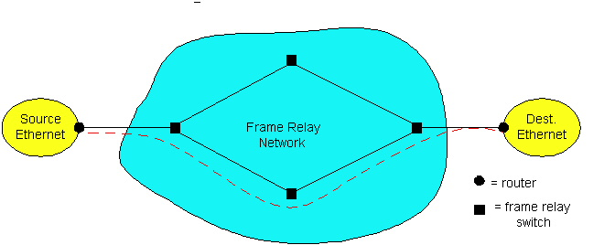
Frame Relay
Designed in late ‘80s, widely deployed in the ‘90s
Frame relay service:
  no error control – assumes NW is reliable
  end-to-end congestion control

Slide 16
Frame Relay (cont.)
Designed to interconnect corporate LANs
  typically permanent VC’s: “pipe” carrying aggregate traffic between two routers
Multiple VCs in one physical link
Corporate customer leases FR service from public Frame Relay network
Committed Information Rate (CIR)
  defined data rate, “guaranteed” for each VC
  negotiated at VC set up time
  customer pays based on CIR

Slide 17
Asynchronous Transfer Mode (ATM)
Data is transmitted and switched in small units called cells (53 bytes)
  Cell Switching
Suitable for data as well as voice and video
Header - 5 bytes
Data - 48 bytes
An ATM Cell

Slide 18
Why Cell Switching?
Need transmission of voice, video, and data
These can no longer be separated
In X.25 and Frame Relay the switching delay is unacceptable for voice and video
Therefore, a switching topology that integrates voice, video and data is needed
Cells can be processed very fast
  Uniform size, simple header

Slide 19
ATM
Small cells enables the same technology to be used for any kind of service
Scalable and flexible
Flexible charging schemes based on the number of cells transmitted is possible
  Bandwidth is not fixed at 64 kb/s 2 Mb/s etc.
Generally uses optical fiber as the transmission medium

Slide 20
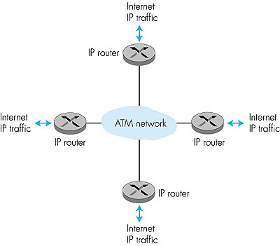
ATM: network or link layer?
Vision: end-to-end transport: “ATM from desktop to desktop”
  ATM is a network technology
Reality: used to connect IP backbone routers
  ATM as switched link layer, connecting IP routers

Slide 21
ATM Layer: Virtual Circuits
VC transport: cells carried on VC from source to dest
each packet carries VC identifier
  not destination ID
every switch on source-dest path maintains “state” for each passing connection
resources (b/w, buffers) may be allocated to VC to get circuit-like performance

Slide 22
ATM
GFC
VPI
Virtual Path Identifier
VPI
VCI
Virtual Circuit Identifier
VCI
VCI
PT
The two-part addressing makes network routing easier and faster
HEC
VCI 1
VCI 1
VCI 2
VPI
VCI 2
VCI 3
VCI 3

Slide 23
A Comparison
Frame Relay
X.25
ATM
Connection Oriented
Yes
Yes
Yes
Normal speed (Mb/s)
0.64
2
155
Switched
Yes
No
Yes
Max. payload (bytes)
128
1600
48
Permanent VCs
Yes
Yes
Yes
Multicasting
No
No
Yes

Slide 24

MPLS
MPLS – Multi-protocol Label Switch: Multi-protocol because can be applied for any layer 2 network protocol
MPLS is a natural evolution of Internet. It is based on IP and routing protocols such as BGP-4,OSPF and IS-IS
Typically MPLS only resides in service providers or carrier network and not in private networks

Slide 25
MPLS Protocol Stack
Application
IP or Multi-Service
MPLS
Layer 2 (PPP, ATM, FR,..)
Physical

Slide 26
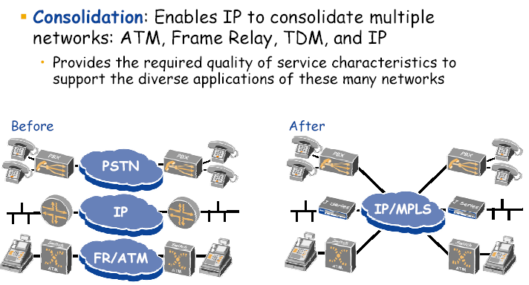
MPLS enables Convergence

Slide 27
What is MPLS ?
MPLS provides connection oriented switching based on a label applied at the edge of an MPLS domain.
IP is used to signal MPLS connections.
Major Applications are:
  Network Scalability
  Traffic Engineering
  VPNs

Slide 28





































Key MPLS Capabilities
RSVP
IP Multicast
IP CoS
Network Scalability
Traffic Engineering
VPN’s

Slide 29

MPLS - Best Of Both Worlds
PACKET
Forwarding
Packet
SWITCHING
HYBRID
IP
MPLS
ATM/FR
Performance
Connection Oriented
Traffic Engineering
Security
QoS
Scalable
Flexible
Easily Deployable
Inexpensive
Dynamic Routing
Route at the Edge & Switch at the Core

Slide 30
Ethernet First Mile (EFM)
connect homes and offices using Ethernet
IEEE 802.3ah standard
Media
  Copper
  Fibre

Slide 31
Ethernet First Mile over Copper (EFMC)
uses DSL modulation schemes with Ethernet frames
objectives
  10 Mbps at 750m (EFMC SR) and
  2 Mbps at 2,700m (EFMC LR)
  existing products deliver higher throughput to longer distances

Slide 32
Ethernet First Mile over Fibre (EFMF)
Point-to-Point
Passive Optical Networks (PON)
Dual fiber standards
  100BASE-LX10
  1000BASE-LX10
Single fiber standards
  100BASE-BX10
  1000BASE-BX10

Slide 33
Summary
Many types of Wide-Area Networks
MPLS and Ethernet are becoming the most prevalent
Technology will keep changing

